Slide 1

Network Layer Routing Algorithm Distance Vector Routing
Lecture 11 | CSE421 – Computer Networks
Department of Computer Science and Engineering School of Data & Science

Slide 2

Objectives
understand principles behind network layer services:
routing algorithms
distance vector
link state

Slide 3
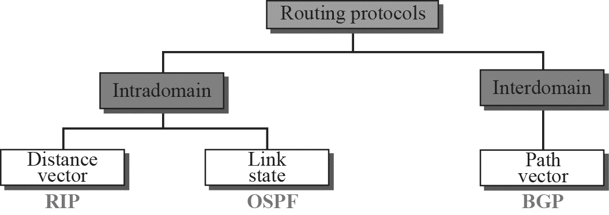
Popular Routing Protocols

Slide 4
Autonomous Systems
Internet is divided into autonomous systems.
An autonomous system (AS) is a group of networks and routers under the authority of a single administration.
Routing inside an autonomous system is called intra-domain routing. Routing between autonomous systems is called inter-domain routing.

Slide 5
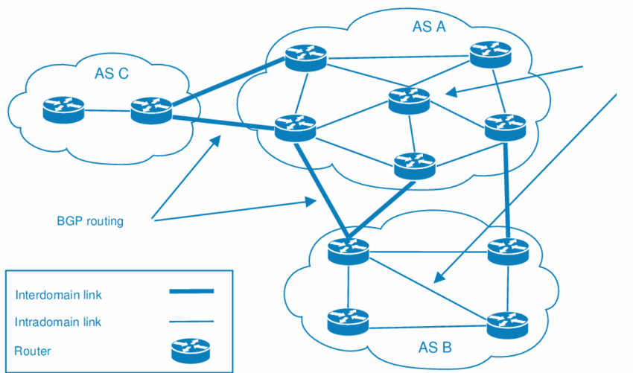
Autonomous Systems
RIP/ OSPF

Slide 6
Routing Algorithms
Given a set of routers and links connecting the routers.
Routing algorithm finds a “good” path from the source to destination router.
Good path = Least cost path

Slide 7
Routing Algorithm classification
Global or Decentralized
Global:
all routers have complete topology and link cost info
“link state” algorithms
Decentralized:
router knows physically-connected neighbors, link costs to neighbors
iterative process of computation, exchange of info with neighbors
“distance vector” algorithms

Slide 8
Distance Vector Algorithm

Slide 9
Distance Vector Algorithm
Based on Bellman-Ford Algorithm
computes shortest paths from a single source node to all of the other nodes in a weighted topology.
Shortest paths are based on the cost calculated from source node to destination node.
Cost for now is arbitrary. It can be calculated using hop counts, link delay, link bandwidth etc.
Distributed route computation using only neighbor’s info

Slide 10
Distance vector algorithm
Basic idea:
Each node periodically sends its own distance vector estimate to neighbors
When a node x receives new DV estimate from neighbor;
It updates its own DV using B-F equation
Notes:
‹#›

Slide 11
Operation of Distance Vector
Periodic Updates:
Periodically broadcast the entire routing table to each of its neighbors (RIP – every 30 seconds).
Inefficient
Router is only aware of the:
Network addresses of its own interfaces.
Network addresses the neighbors running the same routing protocol.
Notes:
Inefficient: Updates consume bandwidth and router CPU resources.
Periodic updates are always sent even there have been no changes for weeks or months.

Slide 12
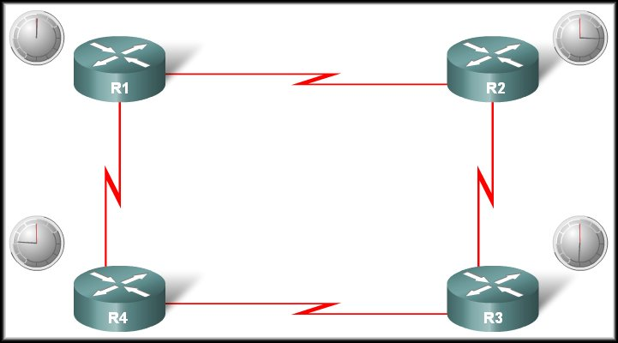

Operation of Distance Vector
Periodic Updates:
R1 Update Timer expires
Neighbour of R1
Updates sent.
Broadcast!
R1 is unaware of R3 and its networks
Neighbour of R1

Slide 13
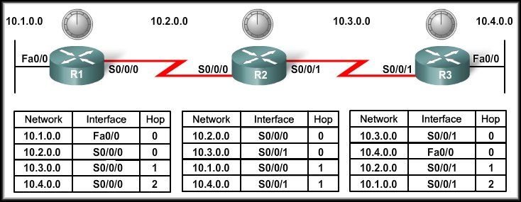
Distance Vector Routing Protocols
Network Discovery

Slide 14
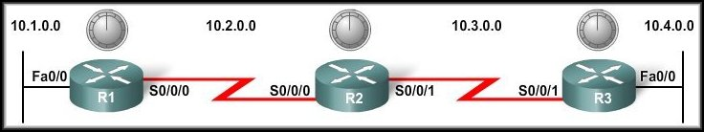
Cold Start
Network Discovery:
Is part of the process of the routing protocol algorithm that enables routers to learn about remote networks for the first time.

Slide 15
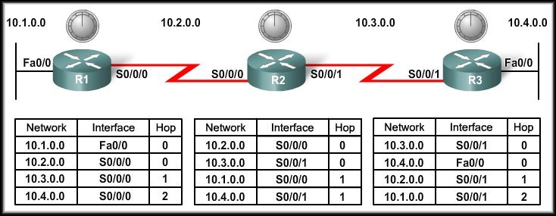
Cold Start
When a router powers up:
Knows nothing about the network topology.
Knows only the information saved in NVRAM.
Sends updates about its known networks out all ports.

Slide 16
Initial Exchange of Routing Information
10.1.0.0
Sends an update about network 10.1.0.0 out the Serial 0/0/0 interface with a metric of 1.
Sends an update about network 10.2.0.0 out the Fa0/0 interface with a metric of 1.

Slide 17
Initial Exchange of Routing Information
10.1.0.0
10.3.0.0
10.2.0.0
Notes:
Sends an update about network 10.3.0.0 out the Serial 0/0/0 interface with a metric of 1.
Sends an update about network 10.2.0.0 out the Serial 0/0/1 interface with a metric of 1.

Slide 18
Initial Exchange of Routing Information
10.1.0.0
10.4.0.0
10.3.0.0
10.2.0.0
Notes:
Sends an update about network 10.4.0.0 out the S0/0/0 interface with a metric of 1.
Sends an update about network 10.3.0.0 out the Fa0/0 interface with a metric of 1.

Slide 19
Initial Exchange of Routing Information
10.3.0.0
10.2.0.0
R1 Receives the update from R2 about network 10.3.0.0 and adds it to its routing table.
R3 Receives the update from R2 about network 10.2.0.0 and adds it to its routing table.

Slide 20
Initial Exchange of Routing Information
10.1.0.0
10.4.0.0
R2 Receives the update from R1 about network 10.1.0.0 and adds it to its routing table.
R2 Receives the update from R3 about network 10.4.0.0 and adds it to its routing table.

Slide 21
Next Exchange of Routing Information
10.1.0.0
Sends an update about network 10.1.0.0 out the S0/0/0 interface with a metric of 1 - AGAIN!
When R2 receives the update, there is no change in information so the update is ignored.

Slide 22
Next Exchange of Routing Information
NEW
NEW
10.3.0.0
10.4.0.0
10.1.0.0
10.2.0.0
Sends an update about networks 10.3.0.0 with a metric of 1 and 10.4.0.0 with a metric of 2 out the Serial 0/0/0 interface.
Similarly sends updates about networks 10.1.0.0 with a metric of 2 and 10.2.0.0 with a metric of 1 out the Serial 0/0/1 interface.

Slide 23
Next Exchange of Routing Information
10.4.0.0
Sends an update about network 10.4.0.0 out the S0/0/0 interface with a metric of 1 - AGAIN!
When R2 receives the update, there is no change in information so the update is ignored.

Slide 24
Next Exchange of Routing Information
10.3.0.0
10.4.0.0
R1 receives an update from R2 about network 10.3.0.0 and there is no change – update ignored.
R1 receives an update from R2 about network 10.4.0.0 (new) and adds it to its routing table.

Slide 25
Next Exchange of Routing Information
10.1.0.0
10.2.0.0
R3 receives an update from R2 about network 10.2.0.0 and there is no change – update ignored.
R3 receives an update from R2 about network 10.1.0.0 (new) and adds it to its routing table.

Slide 26
Next Exchange of Routing Information
The network has CONVERGED!
All routers now know about all of the networks attached to all of their neighbouring routers.

Slide 27
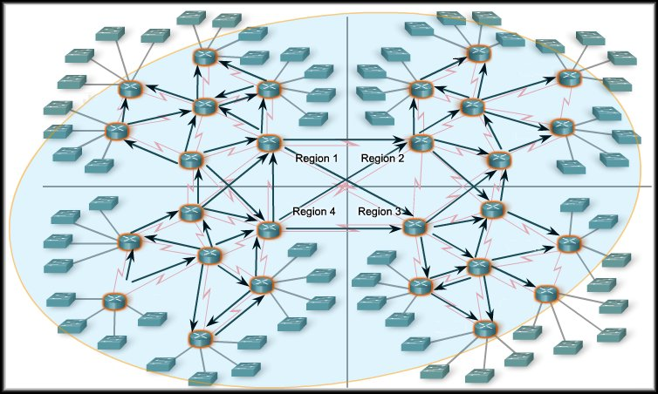
Convergence
The amount of time it takes for a network to converge is directly proportional to the size of that network.
Routing protocols are compared based on how fast they can propagate this information - their speed to convergence.
A network is not completely operable until it has converged.
Network administrators prefer routing protocols with shorter convergence times.

Slide 28
THE END

